Slide 1
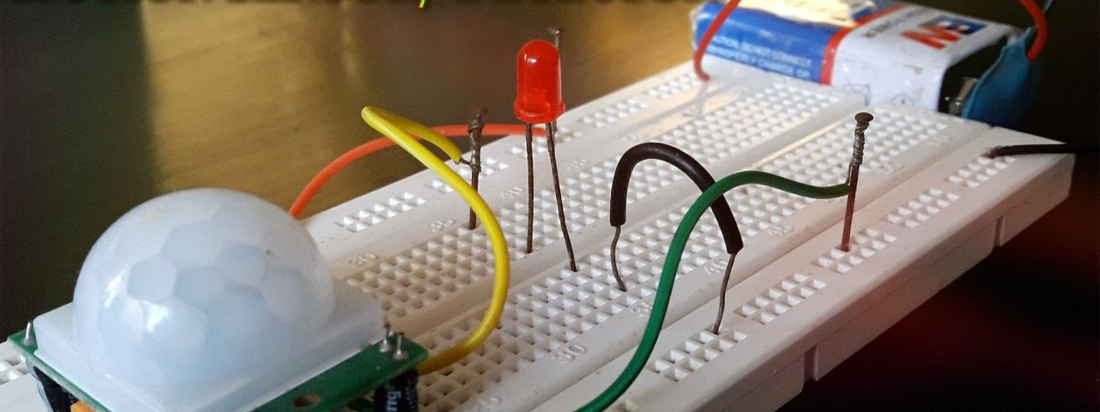
Semester project 2390l :Motion sensor activated motor
By Jordan Pierre and Jackandie Joanis

Slide 2
DOCUMENTATION
The purpose of this project was to control a motor with a motion sensor so that when it detects motion, the motor will turn left or right depending on which sensor picked up movement. The inspiration that led to the creation of this project came simply from the thought,” what if blinds were controlled by motion sensors instead of remotes?”

Slide 3
Components Needed:
Raspberry pi x1
Breadboard x1
PIR Motion Sensor x2
Micro Servo x1
LED’s x2
Rainbow Jumper Wires

Slide 4
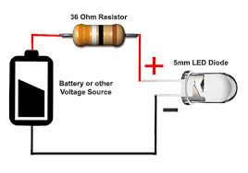
Step One: The Led(S)
Testing reaction between GPIO Pins and breadboard
Testing sending signals through Pins, to Bread Board, to Led

Slide 5
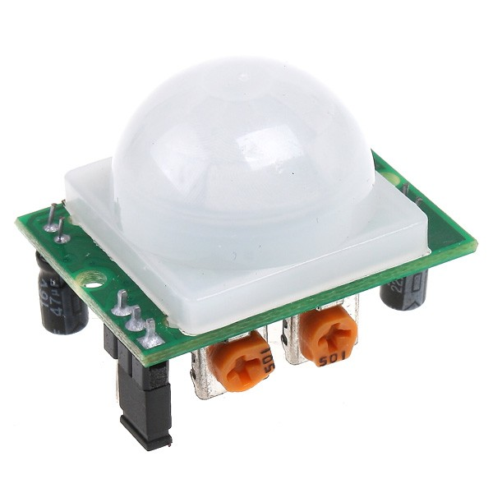
STEP TWO: The Motion Sensor
Testing Input from sensor
Fiddling with sensitivity and time offset

Slide 6
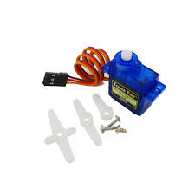
STEP FOUR: THE MOTOR
The PWM(Pulse wave modification)
Determining Duty Cycle

Slide 7
STEP FIVE : The culmination
Incorporating the LED
Incorporating the Sensors
Incorporating the Motor

Slide 8
Challenges
The Sensitivity of the sensors
Calculations for the motor
Time offsets for LEDS
Conditionals in Python

Slide 9
CONCLUSION
We wanted to get the motor to turn the blind up or down, but it turns out that it was neither strong enough or turns enough. So we had to settle for simply turning on or off the shade. There are actually many uses for this kind of setup. The Blind is simply one example.

